Slide 1
Instructional Technology/Print Management
Nate Gross
Cameron Gasmire

Slide 2
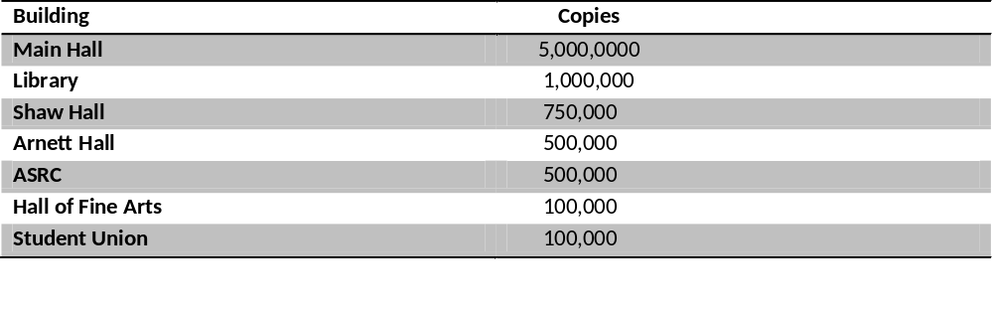
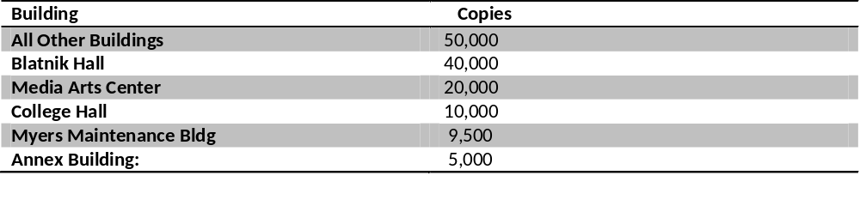
Printer Volume
July 1, 2010 - June 30, 2011

Slide 3
What is Instructional Technology?
the theory and practice of design, development, utilization, management, and evaluation of processes and resources for learning.
Educational technology

Slide 4
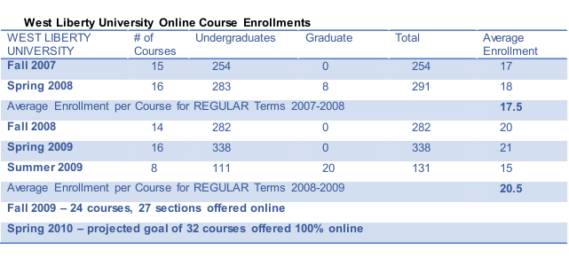
 | 2008-09 | 2009-10 | 2010-11 | 2011-12 | 2012-13
% Faculty using instructional technology to enhance student learning | 65% | 70% | 75% | 80% | 85%

Slide 5
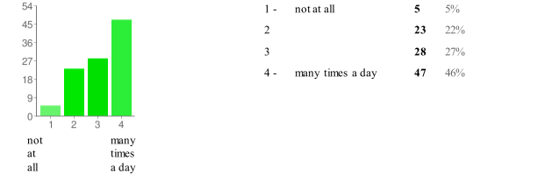
How often teachers use email to support student learning.

Slide 6
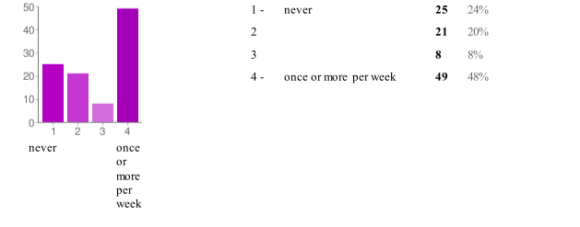
How often do teachers user PowerPoint for student learning.

Slide 7
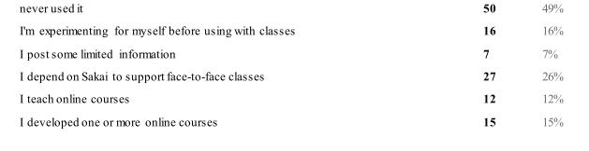
Percentage of teachers using
Sakai for learning.

Slide 8
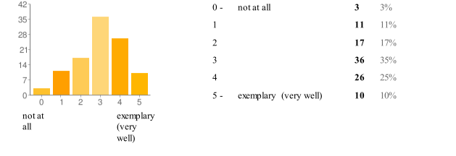
How much teachers believe they use technology for student learning compared to what is possible.

Slide 9
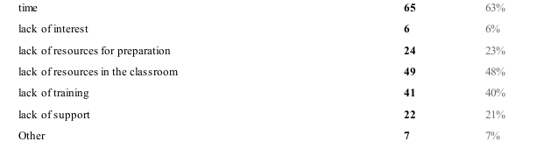
Why teachers choose not to use instructional technology.

Slide 10
Excel Charts

Slide 11
SWOT
Strengths Projectors in nearly every classroom Plenty of online courses being offered Strong IT support Laptop program | Weaknesses Insufficient amount of outlets to support a large amount of students using laptops in most rooms Only about half of professors are utilizing Sakai Professors not suggesting/integrating student laptop usage into the classroom
Opportunities Teachers willingness to conform from traditional teaching methods | Threats Teachers set in their ways Other colleges better utilizing IT

Slide 12
GOALS
Offer weekly workshops on instructional and personal productivity use of technology with attendance by at least 75% of faculty at one or more sessions
Make power outlets more accessible to students that choose to use their laptops in class.
Increase average number of online courses per semester to 26 with a minimum of 20 students per course

Slide 13
GOALS
Provide laptops to at least 80% of faculty
Assess operations of technology and instructional support center and make data-driven decisions about effectiveness
Collect data on faculty needs and uses of instructional technology and viability of instructional support center

Slide 14
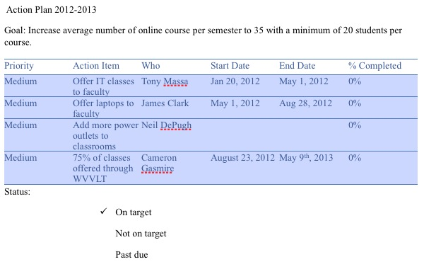
ACTION PLANS

Slide 15
MISSION STATEMENT
West Liberty University will strive to increase the availability, understanding, and utilization of classroom technology.

Slide 16
VISION STATEMENT
Updating West Liberty University to the Information Technology age.

Slide 17
KEY PERFORMANCE INDICATORS
Professors that utilize Powerpoint in the classroom
Professors that utilize Sakai for learning
Outlets available in each classroom
Laptops given to faculty members
Instructional technology classes given
Online courses offered

